Slide 1



Slide 2


Today's agenda
Project recap
Problem
The Analytics team
Process
Insights
Summary

Slide 3

Social Buzz was founded by two former engineers from a large social media conglomerate. Social Buzz emphasizes content by keeping all users anonymous, only tracking user reactions on every piece of content
Tasks to achieve:
Guidance in completing IOP
Help to maintain big data
Find top 5 categories of content
Project Recap

Slide 4

Problem
Every day over 100,000 pieces of content, ranging from text, images, videos and GIFs are posted.
All of this data is highly unstructured and requires extremely sophisticated and expensive technology to manage and maintain.

Slide 5



Andrew Fleming (Chief Technical Architect)
Marcus Rompton (Senior Principle)
Parita Vyas
(Data Analyst)
The Analytics team

Slide 6
Process
1
Identify business questions
2
Collect and store data
3
Clean and prepare data
4
Analyze data
5
Visualize and communicate data

Slide 7

Insights
Customer
preferences
Market
dynamics
Operational efficiency

Slide 8
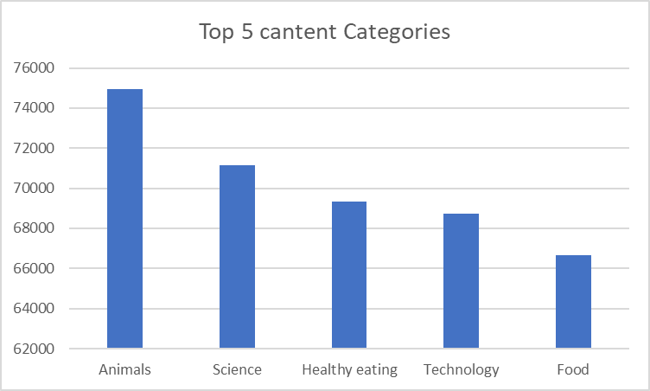

Slide 9
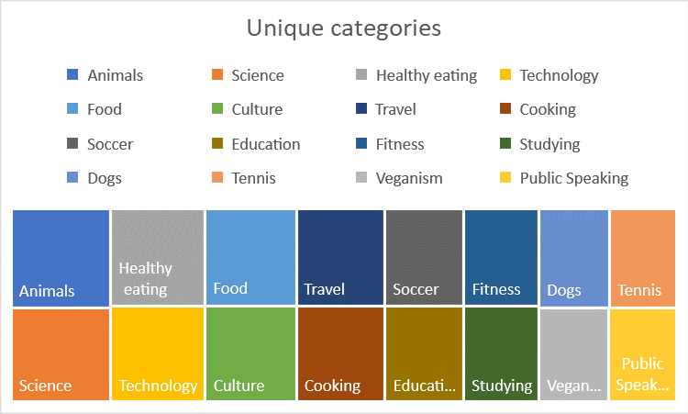

Slide 10
The most popular content category (Animals) has 15 reactions. Which are as follows:
Adore
Cherish
Disgust
Dislike
Hate
Indifferent
Interested
Intrigued
Like
Love
Peeking
Scared
Super love
Want
Worried

Slide 11
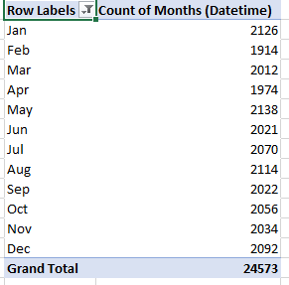
List of months with total number of posts

Slide 12

Understanding the clients requirements
Data gathering
Execute appropriate action
Retrieve the solution
Summary

Slide 13
Thank you!
ANY QUESTIONS?

